Slide 1

Executable Security in a Website
Mackenzie McClellan
Notes:
Hi my name is Mackenzie mcclellan and I will be teaching how to implement security into a website.

Slide 2

Finding the right Host
When building a website, a domain name and host are required. Finding a domain host with the right amount of security is tricky.
Notes:
When building a website, a domain name and host are required. Finding a domain host with the right amount of security is tricky.

Slide 3
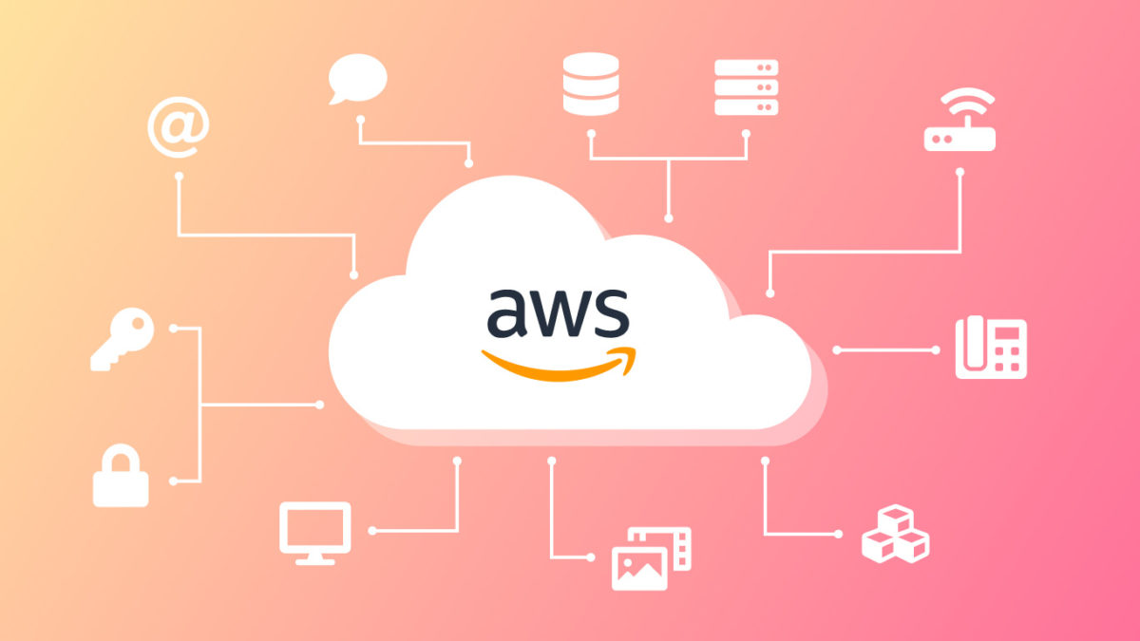

Amazon web Services
Amazon Web Services(AWS) makes flexible pricing models their main selling point when becoming a partner. While a company can just do the baseline or add all their services, like a web application firewall, AWS can grow with you. Allowing one to have all their necessary components in one paid service that they can add/delete at any time.
Pay as you go
Notes:
My first suggestion for a hosting system is amazon web services. Amazon Web Services(AWS) makes flexible pricing models their main selling point when becoming a partner. While a company can just do the baseline or add all their services, like a web application firewall, AWS can grow with you. Allowing one to have all their necessary components in one paid service that they can add/delete at any time.

Slide 4

BlueHost
BlueHost is a prime example of a great host with added security. They have a feature called Web Application Firewall(WAF) which monitors and protects against attacks, like SQL injection and XSS attacks.
8.99 a month
Notes:
Second Is bluehost. BlueHost is a prime example of a great host with added security. They have a feature called Web Application Firewall(WAF) which monitors and protects against attacks, like SQL injection and XSS attacks.

Slide 5


AWS BlueHost
Security
Flexibility
User friendly
(easy to learn)
Customer support
Notes:
These are both great options with customer support and security, but bluehost lacks the flexibility that aws offers, but aws is hard for a user who lacks the knowledge of what they need to make a secuer website because those items need to be added.

Slide 6
For a start-up looking something that will grow with them and is eager to learn about the different components of hosting a website, Amazon Web Services is the best option.
Notes:
For a start-up looking something that will grow with them and is eager to learn about the different components of hosting a website, Amazon Web Services is the best option.

Slide 7

Want to change hosting systems?
One can change their hosting systems at any time. One company will copy the executable files over to any company that one wants to move on to. As a company grows, a more suitable host can be more adequate!
Notes:
one does not have to worry about making the wrong decision either because One can change their hosting systems at any time. One company will copy the executable files over to any company that one wants to move on to. As a company grows, a more suitable host can be more adequate!

Slide 8

A web application firewall is useful to have on its own as well, as it will monitor the traffic on one’s website and prevent some attacks
Notes:
The second thing is a web application firewall, A web application firewall is useful to have on its own as well if a hosting system does not offer it, as it will monitor the traffic on one’s website and prevent some attacks

Slide 9

Cloud Fare
Cloudfare is a web infrastructure and security company that offers free to enterprise level security. This includes more than just a WAF, but includes SSL certificates, Content Delivery Network, and waiting room regulation.
20 a month (Pro)
200 a month (Business(+waiting room regulation))
Notes:
A great example if this is cloudfare. Cloudfare is a web infrastructure and security company that offers free to enterprise level security. This includes more than just a web application firewall, but includes SSL certificates, Content Delivery Network, and waiting room regulation. They have options to upgrade as well, in which will help prevent crashes due to too many requests to your website.

Slide 10
AWS Web application Firewall
Amazon Web Services provide this as part of their package add-ons. As said before, this firewall will attack common breach patterns, while giving the owner the freedom to create security rules that can protect against SQL injection attacks a XSS attacks.
~ 10 a month
Notes:
As said before, amazon web services have many add-ons for a user to implement into their website. This includes a web application firewall, As said before, this firewall will attack common breach patterns, while giving the owner the freedom to create security rules that can protect against SQL injection attacks a XSS attacks.

Slide 11

Prophaze
Prophaze is a free, behavioral based application security. It supports AWS, Oracle and IBM cloud, so one does not have to add the paid services or work around connecting it to the host.
Free
Notes:
Another company is Prophaze. Prophaze is a free, behavioral based application security. It supports AWS, Oracle and IBM cloud, so one does not have to add the paid services or work around connecting it to the host.

Slide 12
If one is looking for a cheap addition to add security, Prophaze is the way to go. Otherwise, if one is looking for top of the line, easy to add security, AWS WAF is the best option.
Notes:
If one is looking for a cheap addition to add security, Prophaze is the way to go. Otherwise, if one is looking for top of the line, easy to add security, AWS WAF is the best option.

Slide 13
Content Management system
Content management systems(CMS) are used on websites to store all web content in one place, this is makes updates more effortless and quicker. This can help save a small business time and money by providing plugins and tools for keeping a website up to date. Also allowing for non-technological start-ups to build an effortless website by providing hassle-free publishing.
Notes:
Now, Content management systems(CMS) are used on websites to store all web content in one place, this is makes updates more effortless and quicker. This can help save a small business time and money by providing plugins and tools for keeping a website up to date. Also allowing for non-technological start-ups to build an effortless website by providing hassle-free publishing. This is not necessarily required, and Bluehost and aws have their own versions that are suitable for this system, but if one was not using these add-ons, or looking for an easier way to publish and update, i would go down this route.

Slide 14

JOOMLA!
JOOMLA is an award-winning Content Management System that can fit any start-ups needs. It is a free, downloadable system that provides web-based management.
Free
Notes:
The first company is joomlA. JOOMLA is an award-winning Content Management System that can fit any start-ups needs. It is a free, downloadable system that provides web-based management.

Slide 15
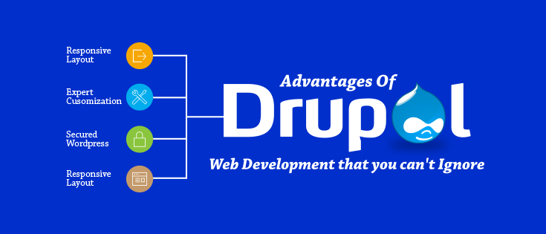
Drupal
Drupal, like JOOMLA, is a free content management system that one can download right off the internet. Drupal also can create a whole website from scratch to suit the needs of your website.
Free download
10,000-40,000 per website
Notes:
Drupal, like JOOMLA, is a free content management system that one can download right off the internet. Drupal also can create a whole website from scratch to suit the needs of your website.

Slide 16
Both Options are trustworthy and free, either one is perfect for a start-up
Notes:
Both Options are trustworthy and free, either one is perfect for a start-up

Slide 17

Up-to-date Website
Maintaining an up-to-date website is important for sustaining security. Updating new version releases of companies used on one’s website is most beneficial. These are constantly being corrected, and in turn, becomes less vulnerable to security threats.
Notes:
Maintaining an up-to-date website is so incredinly important for sustaining security. Updating new version releases of companies used on one’s website like aws, bluehost, and joomla is most beneficial. These are constantly being corrected, and in turn, becomes less vulnerable to security threats. If one does not update these patches, an attackers can use the bug patched in the update against you, and use it to infiltrate.

Slide 18
Self Testing and updating are the most essential step in cybersecurity
Notes:
Self Testing and updating are the most essential step in cybersecurity as well. Finding vulnerabilities in your own website and patching them is always beneficial for the security of your website

Slide 19

95% of breaches are due to human error. Patching your website is something that should always be happening.
Notes:
95% of breaches are due to human error. Patching your website is something that should always be happening.

Slide 20
WAYS TO TEST A WESITE’S SECURITY
WEBSITE SCANNER
CUSTOMER FEEDBACK
SELF-TESTING AND EXPERIENCE
Notes:
There are plenty of ways one can test security, like said before self-testing and customer feedback gives an idea on what needs to be changed, but there is also a scan that you can do that tests the security and tells the owner where there are potential flaws are.

Slide 21
Google malware detection
The google malware checker is free, easy to do, and accurately detects for flagged objects that are susceptible to attacks.
Free
Notes:
One of these tests are provided by google. The google malware checker is free, easy to do, and accurately detects for flagged objects that are susceptible to attacks.

Slide 22

SITElock
Sitelock is a subscription that automatically checks and removes identified malware.
9.99 a month (SMART)
14.99 a month (SMART + automatic back-ups)
Notes:
Another option is sitelock, Sitelock is a subscription that automatically checks and removes identified malware. Which is especially beneficial for users that don’t want to manually scan.

Slide 23
Depending on what level of security that one wants to check there is plenty of options. If One was looking for protection 24/7, Sitelock is the path to take, other wise GMD is a good choice as well for a quick check.
Notes:
Depending on what level of security that one wants to check there is plenty of options. If One was looking for protection 24/7, Sitelock is the path to take, other wise GMD is a good choice as well for a quick check.

Slide 24
Strong & Secure Passwords
Having passwords requirements are the first line of defense against unauthorized users
Notes:
On the other hand, Having passwords requirements are the first line of defense against unauthorized users

Slide 25
A Recommended password must have at least…
8 characters
1 number
1 capital letter
1 special character (limited)
No name/private information used
Notes:
A recommended password must have at least, 8 characters, 1 number, 1 capital letter, 1 special character, and no correlation to public information, like name or birthday,

Slide 26
Secure socket layer CERTIFICATE
For extra security, especially against man in the middle attacks, having an SSL certificate to encrypt your data between the website and webserver.
Notes:
Lastly, For extra security, especially against man in the middle attacks, having an SSL certificate to encrypt your data between the website and webserver is extremely beneficial , some application firewalls provide this, like cloudfare.

Slide 27
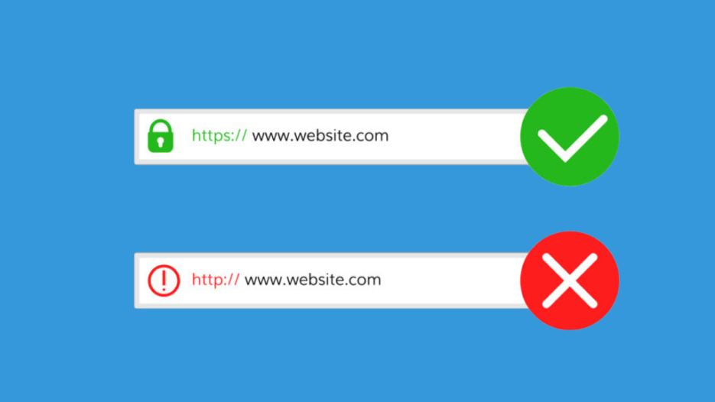
Becoming SSL certified also adds comfort to the costumer because their browser will recognize the browser as secure when visiting.
Notes:
Becoming SSL certified also adds comfort to the costumer because their browser will recognize the browser as secure when visiting.

Slide 28






BlueHost
PLAN 1
Prophaze
+ JOOMLA (optional)
SiteLock
SSL Certificate
18.98 a month
Notes:
With all this is mind, I have set two example plans that one could choose to go down. Starting with bluehost, then the firewall prophaze and then the optional content management system JOOMLA, then site lock, that will constantly deflaw your site, and lastly the ssl certificate.

Slide 29

Amazon Web Services
PLAN 2
AWS Web Application Firewall
JOOMLA!
GOOGLE MALWARE DETECTION
SSL Certificate
~50 a month
Notes:
The second plan will start off with amazon web services and the web application firewall, followed by the optional JOOMLA, and then the free google malware detection, ending with the ssl certificate.

Slide 30
In addition, Strong Password Requirements and consistently patching your own website needs to be apart of both plans
Notes:
In addition, Strong Password Requirements and consistently patching your own website needs to be apart of both plans
Although there are many variations of this plan in which one could choose to go down, any of these steps will be valuable to the security of a website. Thank you.

